Slide 1
CLUSTERING - Important Concepts
Unsupervised Learning
Why Clustering?
Types of Clustering
Concept of Distance
Concept of Linkage
Partition Clustering
K-Means Clustering
Steps in K-Means Clustering
Cluster Centroids
WSS
Quality of Clusters – Silhouette Scores

Slide 2
Why Clustering

Slide 3
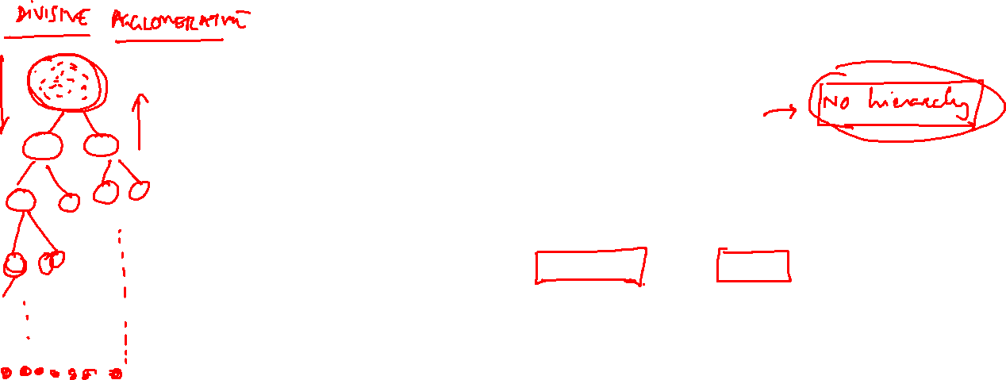
Types of Clustering
Clustering
Hierarchical
Divisive
Agglomerative
Partitioning
K-Means
PAM

Slide 4
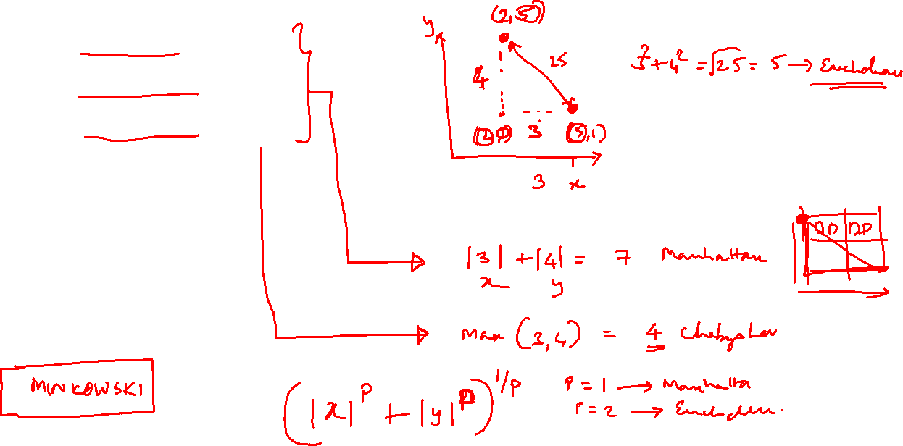
Concept of Distance
Euclidean Distance
Manhattan Distance
Chebyshev Distance

Slide 5
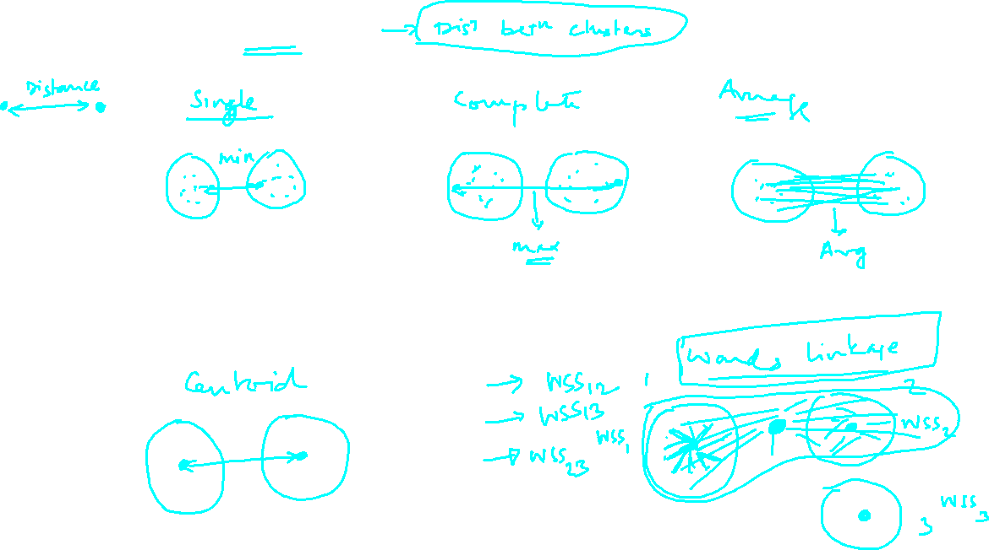
Concept of Linkage

Slide 6
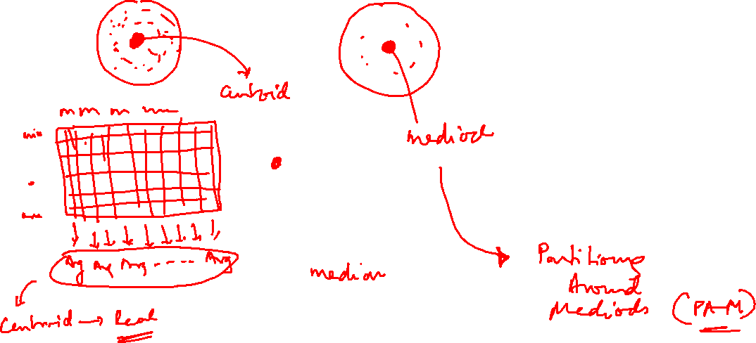
Cluster Centroids –What is it?

Slide 7

Partition Clustering
K-Means Clustering
PAM Clustering

Slide 8





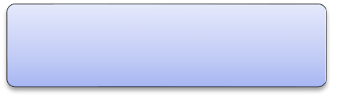





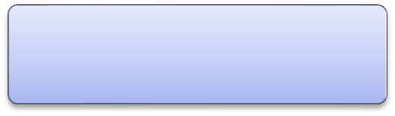
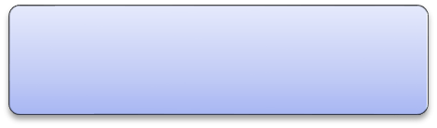
Steps in K-Mean Clustering
Derive # of clusters
using scree plot
Specify value of K
Partition dataset to K initial clusters
Assign each record to cluster with nearest centroid
Yes
Recalculate centroids for losing and receiving clusters
Do reassignments occur?
No
Finalise clusters

Slide 9

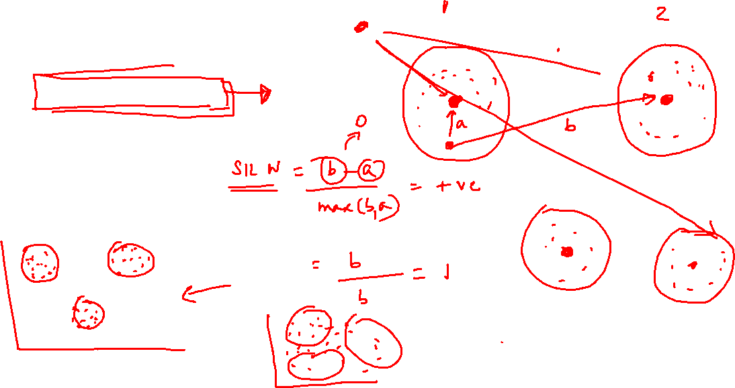
Quality of Clusters
Silhouette width /sample
Silhouette Score

